Slide 1
Binary Prediction of Poisonous Mushrooms
Abheesht Roy ASU ID – 1233225866
CSE 572

Slide 2
Today’s agenda
Background
Problem Statement
Challenges
Data
Pipeline
Results
Next Steps

Slide 3
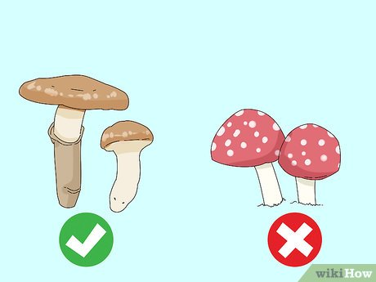
Background
Mushroom foraging is common worldwide
Visual identification is difficult & risky
Mushroom classification is a classic ML dataset
Kaggle Playground: synthetic but realistic data

Slide 4
Problem Statement
Build a system to predict whether a mushroom is edible or poisonous
Use physical/categorical features like cap shape, color, odor, and gill type
Formulated as a binary classification task with two classes: edible (e) and poisonous (p)
Competition performance measured using Matthews Correlation Coefficient (MCC)

Slide 5
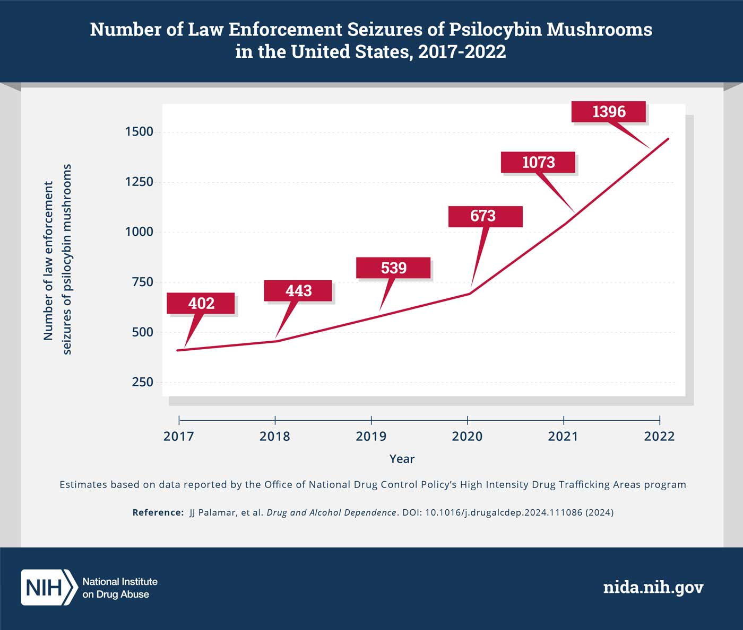
Why It Matters
Health & Safety: Eating poisonous mushrooms can be fatal
Visual identification is unreliable even for experienced foragers
Educational value: Classic dataset for learning classification
Data mining practice: Real-world, high-stakes prediction task

Slide 6
Challenges
Categorical features only → require encoding before modeling (e.g., one-hot, ordinal encoding)
Feature explosion & high dimensionality → many new variables after encoding
Possible class imbalance → edible vs. poisonous distribution may skew results
Overfitting risk → synthetic dataset + many features can cause poor generalization
Metric choice (MCC) → harder to optimize than simple accuracy, must handle all error types
Feature redundancy → some attributes may carry duplicate or low-value information

Slide 7
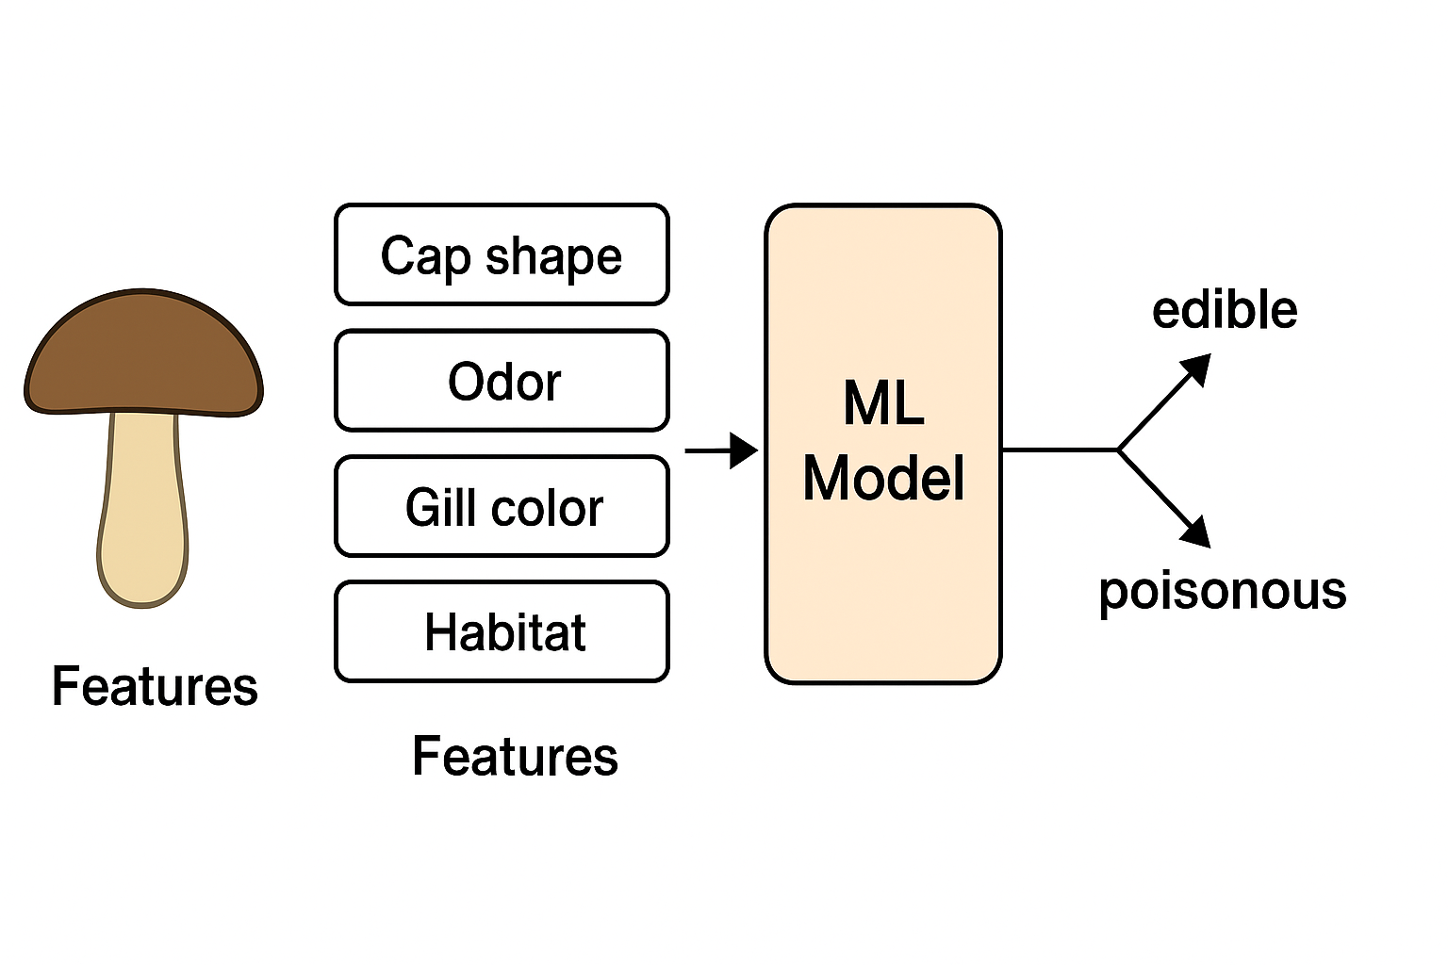
Problem Formulation
Task type: Supervised Binary Classification
Input: Mushroom attributes (cap shape, odor, gill color, habitat, etc.)
Output: Target label → edible (e) or poisonous (p)
Prediction objective: Build a model that maps features → class label
Evaluation: Matthews Correlation Coefficient (MCC)
Formally:
Learn function f(X) → y, where X = feature vector, y ∈ {e, p}

Slide 8
Planned Data Mining Pipeline
Data Collection → Kaggle Mushroom dataset (synthetic, labeled)
Data Preprocessing
Handle categorical variables (one-hot/label encoding)
Remove/merge redundant features
Check for missing values
Exploratory Data Analysis (EDA)
Visualize feature distributions & class balance
Identify strong predictors (e.g., odor, spore print color)
Modeling
Baseline: Logistic Regression, Decision Trees
Advanced: Random Forest, XGBoost, Neural Network (optional)
Evaluation
Train/test split, cross-validation
Metrics: Accuracy, Precision/Recall, MCC
Comparison & Selection → choose best-performing model

Slide 9
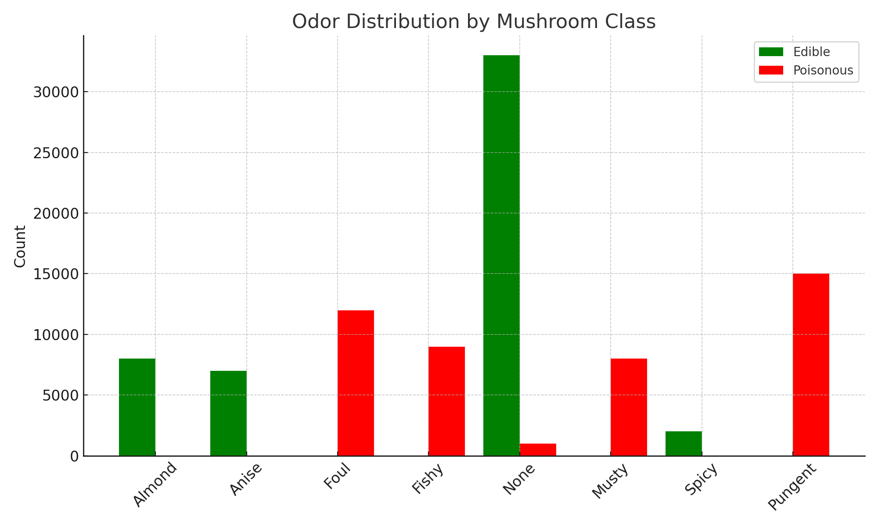
Initial Data Exploration
Initial Observations
Dataset size: ~95,000 rows, ~20 features
All features are categorical (no numeric variables)
Balanced classes: edible vs poisonous fairly even (≈50/50 split)
Some features show strong correlation with class (e.g., odor, spore print color)
Others appear less informative (e.g., veil color)

Slide 10
Data Readiness & Preprocessing
Can the data be fed directly? → No
Features are categorical, not numeric
Some attributes are redundant or low-value
Dataset must be transformed before modeling
Planned Preprocessing Steps
Encode categorical features (one-hot, label encoding)
Remove/merge redundant features (e.g., veil color)
Train-test split & cross-validation setup
Normalize if required for certain models (e.g., logistic regression)

Slide 11
Data Quality After Preprocessing
After Preprocessing
Dataset fully numeric → suitable for ML models
Redundant/low-value features removed
Encoded features standardized into consistent format
No missing values → complete dataset
Balanced class distribution preserved
Ready for training, validation, and testing
Raw: odor=almond, cap-shape=convex
Encoded: [odor_almond=1, odor_fishy=0, cap_shape_convex=1, cap_shape_flat=0].)

Slide 12
Next Steps
Implement baseline models (Logistic Regression, Decision Tree)
Train advanced models (Random Forest, XGBoost, Neural Network)
Compare results across models using MCC and other metrics
Perform hyperparameter tuning & feature selection
Document results for progress checkpoints & final report

Slide 13
Presentation link
https://drive.google.com/file/d/1_OgVNoOaIpmptJeDjNmaBbNOz_smlJ6K/view?usp=sharing

Slide 14

Closing slide

